Slide 1
MTSA
33 CFR 105.210
Training for Personnel with Security Duties.

Slide 2
Commonly Used MTSA Acronyms
AMS Area Maritime Security
AOR Area of Responsibility
ASP Alternate Security Program
CFR Code of Federal Regulation
CDC Certain Dangerous Cargo
COTP Captain of the Port
CSO Company Security Officer

Slide 3
Commonly Used MTSA Acronyms
DHS Department of Homeland Security
DOS Declaration of Security
FMSC Federal Maritime Security
FSO Facility Security Officer
FSP Facility Security Plan
HSAS Homeland Security Advisory System

Slide 4
Commonly Used MTSA Acronyms
IMO International Maritime Organization
ISPS International Ship & Port Security Code
JTTF Joint Terrorism Task Force
MARSEC Maritime Security
MTSA Maritime Transportation Security Act
NFSPRC National Facility Security Plan Review Center
OCS Outer Continental Shelf

Slide 5
Commonly Used MTSA Acronyms
SOLAS Safety of Life at Sea
SSI Sensitive Security Information
TSA Transportation Security Administration
TSI Transportation Security Incident
USCG United States Coast Guard
VSP Vessel Security Plan

Slide 6
Break
MTSA General History

Slide 7
Learning Objectives
At the end of this course, students will know and be able to apply the following:
Demonstrate knowledge of the Maritime Transportation Security Act (MTSA), and the required knowledge as listed in 33 CFR 105.210.
Perform their duties within federal regulation.

Slide 8
September 11, 2001
On the morning of September 11, 2001, 2 American passenger aircraft were intentionally flown into the World Trade Center Twin Towers.
The impact of this act was such a shock to the American people that most of us can still remember exactly what we were doing when the news broke.
A third aircraft was flown into the Pentagon and the fourth aircraft crashed before hitting its’ target, thanks to brave men and women on board, refusing to let the terrorist accomplish their mission.
The attacks resulted in the deaths of 2,996 people and the injuries of 6,000+ others. The 2,996 death toll included 265 on the four planes (from which there were no survivors), 2,606 in the World Trade Center and in the surrounding area, and 125 at the Pentagon.
This sparked the realization that the U.S. needed to take terrorism seriously and needed to react accordingly.

Slide 9
Congress & POTUS take Action
Immediately, our government brought forward legislation to give Law Enforcement Agencies the power to combat illegal immigrants, penetrate Islamic Fundamentalist cells, and increase our intelligence gathering authority and expertise
THE PATRIOT ACT was signed into law by President George W. Bush on October 26, 2001.

Slide 10
Transportation Industry
Because airplanes were used in attacking civilians, the airline transportation industry was immediately reviewed and the lack of security was astonishing.
Then we turned our eyes to the Maritime Transportation System (MTS).
We noticed our ports and waterways had become highly vulnerable since WWII.
There were virtually no security at shipping terminals or our harbors and river systems.
Foreign crews and pe[rsonnel were able to walk off a ship right into our towns and cities; from there, anywhere in the United States, all unchecked.

Slide 11
MTSA of 2002
On November 25, 2002, President George W. Bush signed into law the Maritime Transportation Security Act (MTSA).
MTSA contained several provisions intended to enhance America’s maritime community against the threat of terrorism.
MTSA aligns with the International Ship and Port Facility Security Code (ISPS).
MTSA has a broader application than the ISPS and includes domestic vessels and facilities.
The U.S. Coast Guard issued regulations in 33 CFR (Code of Federal Regulations) that include requirements for Port Security Committees and Port Security Plans, Vessel Security Assessments and Security Plans, Vessel and Company Security Officers, Facility Security Assessments and Plans, and Facility Security Officers.

Slide 12
Implementation and Enforcement
After MTSA became law, the responsibility was placed upon the U.S. Coast Guard to implement and enforce the law.
33 CFR was written, reviewed and then finalized. 33 CFR subchapter H (Maritime Security) delves into the detail of the public’s responsibilities and requirements that were implemented on July 1, 2004.

Slide 13
Questions?
Relevant provisions of the Facility Security Plan (FSP)

Slide 14
Facility Security Plan
What is it?
Facility Security Plan (FSP) means the plan developed to ensure the application of security measures designed to protect the facility and its servicing vessels or those vessels interfacing with the facility, their cargoes, and persons on board at the respective MARSEC Levels.
In layman’s terms, it means your employer or owner of the property has written a plan to deal with security threats. Also, if foreign (SOLAS) vessels visit this property there are procedures and protocols on how to handle these people and vessels.

Slide 15
What’s Included in the Plan?
Security Administration and Organization of the Facility
Personnel Training
Drills and Exercises
Records and Documentation
Response to change in MARSEC Levels
Procedures for interfacing with vessels
Declaration of Security
Communications
Security systems and equipment maintenance
Security measures for access control, including designated public access areas
Security measures for handling cargo
Security measures for delivery of vessel stores and bunkers
Security measures for monitoring
Security incident procedures
Audits and Security Plan amendments
Facility Security Assessment (FSA) report; and
Facility Vulnerability and Security Measures Summary (Form CG-6025)

Slide 16
The Organization of the Facility
FSO, PSD’s, and AO’s
Explained:
Security administration and organization of the facility;
Facility Security Officer
Personnel w/Security Duties
All Other Facility Personnel.

Slide 17
Required Training
Personnel Training:
33 CFR 105.205 FSO Training
33 CFR 105.210 Personnel w/Security Duties Training.
33 CFR 105.215 All other Facility Personnel Training

Slide 18
Personnel Training
Required Knowledge:
Personnel w/Security Duties required Training:
33 CFR 105.210
Knowledge of current security threats and patterns.
Recognition and detection of dangerous substances and devices.
Recognition of characteristics and behavioral patterns of persons who are likely to threaten security.
Techniques used to circumvent security measures.
Crowd management and control techniques.
Security related communications
Knowledge of emergency procedures and contingency plans.

Slide 19
Personnel Training
Required Knowledge
Personnel w/Security Duties Training Continued:
Operation of security equipment and systems.
Testing, calibration, and maintenance of security equipment and systems.
Inspection, control and monitoring techniques.
Relevant provisions of the Facility Security Plan (FSP).
Methods of physical screening of person, personal effects, baggage, cargo, and vessel stores.
The meaning and the consequential requirements of the different MARSEC Levels.
Familiar with all relevant aspects of the TWIC program and how to carry them out.

Slide 20
Break
Knowledge of current security threats and patterns

Slide 21
Knowledge of current Security Threats and Patterns
How to Recognize a Threat.
Types of Threats
Terrorism: Groups such as ISIS, HAMAS, HIZBALLAH, Al-Qa’ida and BOKO HARAM
Organized Crime: Groups such as Colombian Drug Cartels, Mexican Cartels, and the Mafia.
Lone Criminal Act: such as Theft, criminal mischief, drug smuggling, assaults; when the perpetrator is acting alone.
Cyber: Malware, spyware, and ransomware.
Civil Unrest: Riots, “Protesters”

Slide 22
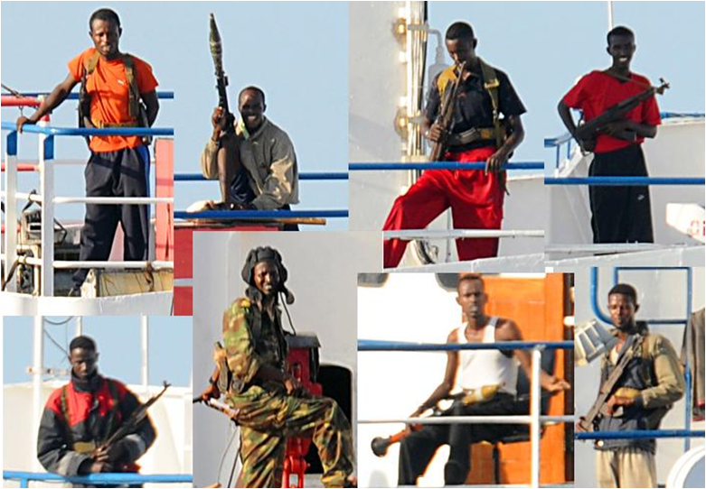
Terrorist Threats
Piracy:
Piracy off the coast of Somali has become an increasingly prevalent threat to the international shipping industry in recent years.

Slide 23
Terrorist Threats
Throughout the U.S. history, terrorists were insignificant in the scheme of things and were truly not a threat to national security.
This all changed in October of 1985 with the hijacking of the Italian cruise ship the Achille Lauro. This was the first Major maritime impact.

Slide 24
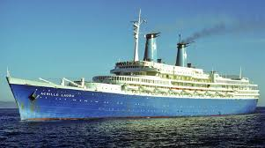
Achille Lauro October 1985

Slide 25
What Happened to the Achille Lauro?
Four heavily armed Palestinian terrorists hijacked the Achille Lauro, carrying more than 400 passengers and crew, off the coast of Egypt.
The hijackers demanded that Israel free 50 Palestinian prisoners.
The terrorists killed a disabled American tourist, 69 y/o Leon Klinghoffer, and threw his body overboard with his wheelchair.
After a 2 day standoff, the hijackers surrendered in exchange for a pledge of safe passage.
But when an Egyptian jet tried to fly the hijackers to freedom, U.S. Navy fighter pilots intercepted it and forced it to land in Sicily.
The terrorists were taken into custody by Italian authorities. Counter-terrorist units from the United States responded, however the situation was resolved before an assault had become necessary.

Slide 26
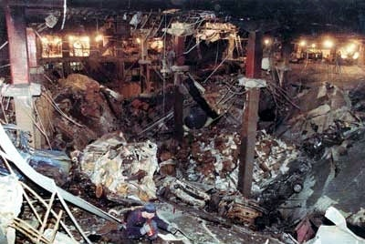
Moving forward to the 1990’s
Notes:
World Trade Center Bombing in 1993

Slide 27
1993 World Trade Center Bombing
In the 1990’s, hate for Americans had been growing.
The first major attack in the U.S. was the truck bombing of the World Trade Towers.
We caught the perpetrators quickly and put them in jail.
We bombed a couple of countries that were fostering terrorist training camps and went back to our strong economy.
Americans felt that the bombing of the World Trade Center was an isolated incident, but this was just the beginning of a war in which the U.S. was not fully engaged.

Slide 28
The Lone Criminal
This is your typical thief, vandal and trouble maker.
They tend to look for “easy targets” unlocked vehicle, offices, items left in the open and points of easy access to areas.
These types of individuals are generally not given direction to commit a crime and make these decisions on their own to benefit themselves.

Slide 29
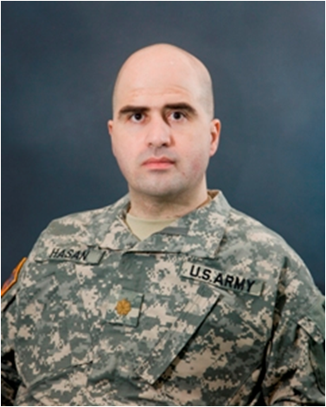
“Lone Wolf” Terrorists
“Lone Wolf” terrorists are persons who commit violent acts in support of some group, movement, or ideology- but do so alone, outside of formal command structure.
Nidal Malik Hasan, a U.S. Army Major, is the accused Fort Hood shooter, an attack that occurred in November 2009.

Slide 30
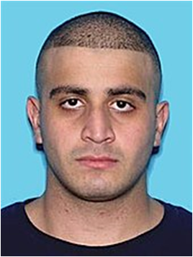
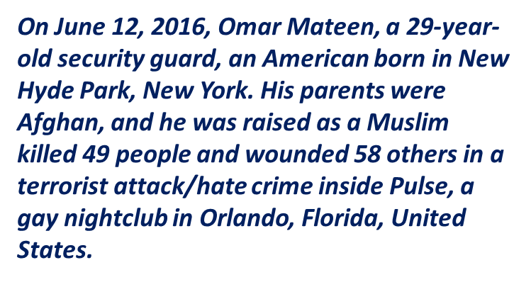
“Lone Wolf” Terrorists
Pulse Nightclub

Slide 31
March 23, 2013 - Syria
The Syrian military is said to believe that a homemade, locally-manufactured rocket was fired, containing a form of chlorine know as CL17, easily available as a swimming pool cleaner.
They claim that the warhead contained a quantity of the gas, and was dissolved in saline solution.
26 People were killed

Slide 32
April 13, 2013 - Boston
Two explosives at the Boston Marathon.
The bombs exploded about 12 seconds and 210 yards apart at 2:49 P.M., near the marathon’s finish line on Boylston Street.
The devices were made of pressure cookers filled with nails and ball bearings; sending shrapnel over a wide area.
The explosion killed 3 civilians and injured an estimation 264 others.

Slide 33
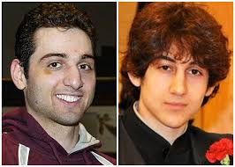
April 13, 2013 - Boston

Slide 34
ARIZONA
Sheriff Arpaio is known for his strong stance against illegal immigration into the U.S. and particularly Arizona.
An explosive device was sent to Sheriff Joseph Arpaio in a package.
It was intercepted before it was detonated and no-one was injured.

Slide 35
Washington DC
On April 16, 2013 letters containing the deadly chemical Ricin were mailed to President Obama and Senator Wicker.
Both letters, which were mailed from Memphis, Tennessee, included the phrases “ No one wanted to listen to me before. There are still Missing Pieces. Maybe I have your attention now even if that means someone must die.”
Both letters were intercepted at the U.S. Postal service facility.

Slide 36
April 21, 2013 – Spring City, TN
The Tennessee Valley Authority, which operates the Watts Bar Plant, notified the NRC that a security officer patrolling on TVA property near the Tennessee River exchanged gunfire with an individual.
This location is outside the plant’s protected area. The officer was not injured and local law enforcement assisted in the response to the incident.

Slide 37
April 22, 2013
Canadian police and intelligence services arrested two suspects who allegedly planned to derail a passenger rail train in Greater Toronto.
The Royal Canadian Mounted Police called it a “Major terrorist attack.”
Chiheb Esseghaier, 30, of Montreal and Raed Jaseer, 35, of Toronto, had received “direction and guidance” from “al-Qaeda elements” in Iran.

Slide 38
December 2, 2015
Inland Regional Center in San Bernardino, California, which consisted of a mass shooting and an attempted bombing.
The perpetrators, Syed Rizwan Farook and Tashfeen Malik, targeted a San Bernardino County Department of Public Health training event and Christmas party.
14 People were killed and 22 were seriously injured in the terrorist attack.

Slide 39
June 12, 2016
The Pulse in Orlando, Florida, a terrorist conducted a mass shooting inside the gay nightclub.
Omar Mateen, 29, killed 49 people and wounded 53 others in this terrorist attack.
This is said to be the deadliest mass shooting by a single shooter, and the deadliest terrorist attack in the U.S. since the September 11th attacks in 2001.

Slide 40
Organized Crime
Organized crime is a category of transnational, national, or local groupings of highly centralized enterprises run by criminals who intend to engage in illegal activity, most commonly for money and profit.
Types of criminal activity committed:
Sex trafficking,
Drug smuggling,
Weapons trafficking (Fast and Furious)
Terrorism
Cyber warfare, Computer Viruses
Labor Racketeering
Illegal immigration and people smuggling

Slide 41
Cyber things to Consider
Virus Protection
User Policies
Thumb drives
Installation of applications
Personal laptops/tablets
Network access
Access to Network server, and server rooms.

Slide 42
Break
Recognition and detection of dangerous substances and devices

Slide 43
Dangerous Substances and Devices
Weapons of Mass Destruction
- Biological
- Nuclear
- Incendiary
- Chemical
- Explosive

Slide 44
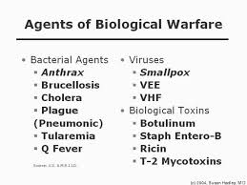
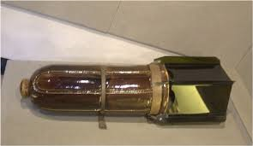
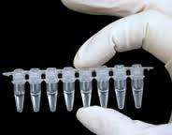
Biological Weapons

Slide 45
Biological Warfare
What is a Biological Warfare?
Biological Warfare, also known as germ warfare, is the use of biological toxins or infectious agents such as bacteria, viruses, and fungi with the intent to kill or incapacitate humans, animals or plants as an act of war.

Slide 46
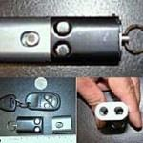
Disguised Weapons
This gun fires .32 caliber automatic rounds.
The keychain gun is typically light in weight and is easily kept in pockets or around the neck.
This item typically will not activate most airport metal detectors.

Slide 47
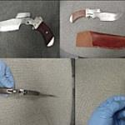
Disguised Weapons
This is a knife that is also a single shot .22 caliber pistol.
Powell and Brown, of Tucson, AZ, manufacture this item.

Slide 48
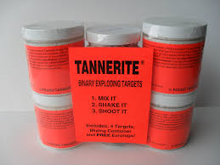
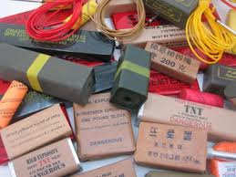
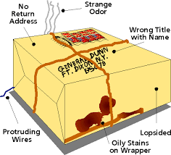
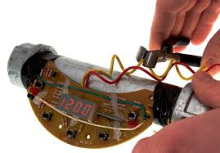
Explosives

Slide 49
Parcel Bombs
Letter and Parcel Bomb Recognition Points.
Foreign Mail, Air Mail, and Special Delivery
Restrictive Markings, such as Confidential, Personal, etc.
Excessive Postage
Hand Written or Poorly typed address.
Protruding Wires or tinfoil.
Excessive Securing Material such as Masking Tape, String, etc.
Incorrect Titles
Titles by No Names
Misspelling of Common Words
Oily Stains or Discolorations
No Return Address
Excessive Weight
Rigid Envelope
Lopsided or Uneven Envelope
Visual Distractions

Slide 50
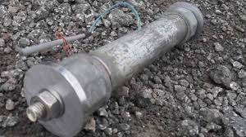
Pipe Bombs
A Pipe Bomb is a homemade bomb, the components of which are contained in a pipe.

Slide 51
Tannerite
Tannerite is the brand name of a binary explosive marketed primarily for making exploding targets for firearms practice.
It is a patented combination of ammonium nitrate and aluminum powder that is supplied as two separate powders that are mixed and shaken to produce an explosive.
When mixed in larger quantities, it can be VERY destructive.

Slide 52
Break
Recognition of characteristics and behavioral patterns of persons who are likely to threaten security

Slide 53
Recognizing Characteristics and Behavioral Patterns of Persons
Who Are Likely to Threaten Security
33 CRF § 105.210 (C)

Slide 54
Suspicious Persons
“PEOPLE ARE NOT SUSPICIOUS, BEHAVIOR IS”
Although we all say “suspicious person” when in fact it is their behavior that is suspicious not the person themselves.

Slide 55
Suspicious Persons
How do we Identify Potential Security Risks?
Are there profiles of people who can or should be considered security risks?
Typical (stereotypical) profile:
18-23 year old
Male
Single
Profile Busters
Educated
Women
Older
Married

Slide 56
Suspicious Persons
Possible Indicators
Persons conducting surveillance, particularly access points.
Persons appearing to execute “dry runs”.
Persons attempting to purchase access to sensitive information:
I.e.… Blueprints/technical drawings
Operations Schedules
Details of security systems/procedures
Personnel Information

Slide 57
Suspicious Persons
Wearing oversized coats or inappropriate attire for weather conditions.
Entering premises on pretext
Loitering near premises
Wandering on facility
Asking specific questions of security
Uncooperative, evasive when questioned
Appears nervous or anxious when questioned.
Making unexpected delivery
Placing a parcel within or just outside facility

Slide 58
Stereotyping/Profiling
Stereotyping:
Definition: A conventional or formulaic conception or image.
A stereotype is a preconceived notion.
Profiling:
Definition: The use of personal characteristics or behavior patterns to make generalizations about a person.
I.e. Racial Profiling, Gender Profiling

Slide 59
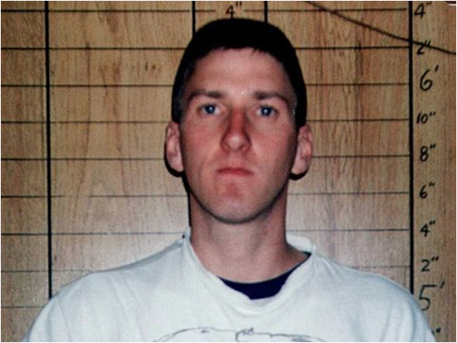
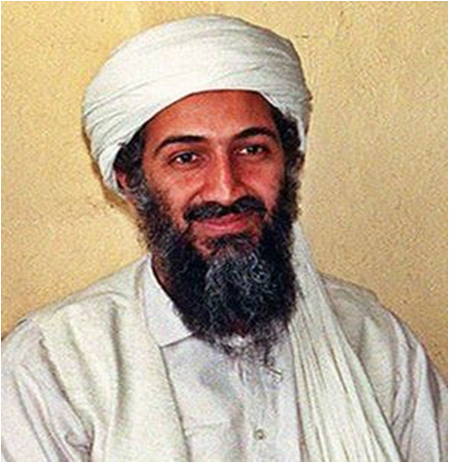
Recognizing Suspicious Activities
One of the biggest mistakes you can make is to stereotype a threat:
Be suspicious and don’t discount unusual behavior solely because the individual doesn’t fit a pre-conceived notion of a threat. It may be the person you don’t expect that will be successful in executing his or her plan.

Slide 60
Suspicious Vehicles
Unmanned
Haphazardly parked
Overly weighted down
Presence of suspicious materials inside
Presence of foreign objects under vehicle
Signs of being tampered with (broken ignition, broken locks etc..).

Slide 61
Break
Techniques Used to Circumvent Security Measures

Slide 62
Techniques Used to Circumvent Security Measures
Disabling of alarm systems
Picking of locks
Jamming of radio signals
Use of Ladders or other equipment to dig under or climb over security fencing.
Using vehicles to ram gates or fences.
Piggybacking through access points
Using Fraudulent ID’s to gain unauthorized access
Posing as a contractor, employee or government agent.
Developing software to bypass computer firewall systems.
Cutting power to critical systems.

Slide 63
Break
Crowd Management and Control Techniques

Slide 64
Crowd Management and Control Techniques
Crowd management means providing a safe and organized setting for patrons entering your facility.
The structures of how to handle the ingress and egress of person(s) at your facility will be described in the Facility Security Plan (FSP).
It is important to treat everyone with respect, remain calm but stay firm on the rules and if the situation starts to progress past your abilities, contact your supervisor for assistance.

Slide 65
Break
Security Related Communications

Slide 66
Security Related Communications
There are many types of communications.
They are listed in the following order as they should be used.
VHS Radio Communications
Land Line Communications
Cell Phone Communications (in allowed areas)
E-mail Communications

Slide 67
Break
Emergency Procedures and contingency Plans

Slide 68
Emergency Procedures and contingency Plans
As facilities differ, so will their emergency procedures and contingency plans.
These procedures will generally be contained in the facility’s Emergency Response Plan and/or the Facility Security Plan.
Procedures on how to deal with emergencies should also be incorporated into the Post Order at each security post.
It is extremely important to become very familiar with the procedures so you feel confident in applying them in real life scenarios.

Slide 69
Break
Security Systems and their Operation

Slide 70
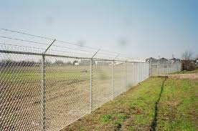
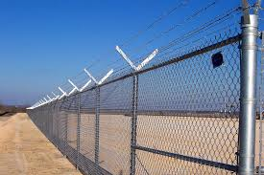
Security Systems and their Operation
8’ Tall with post concreted into ground.
Correctly installed, secured firmly to post at all locations.
Taut barbed wire, Cabled
Serves to Identify, Direct, Segregate and Deter unauthorized entry.

Slide 71
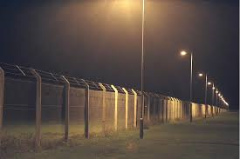
Lighting Systems
Lighting must NOT interfere with navigation;
All areas must be illuminated.

Slide 72
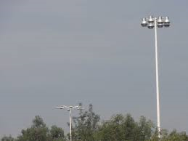
Lighting Systems
You want to have continuous lighting throughout the facility and eliminate possible dark areas.
Lighting that has the beams overlapping will help eliminate those areas.

Slide 73
Video Surveillance/CCTV
Pan, Tilt, Zoom
Color vs. Black and White
Low Light/Night Vision or Infrared
Concealed Surveillance
Alarm activated smart cameras
Command Center
Master / Split Monitor
Recorded imagery

Slide 74
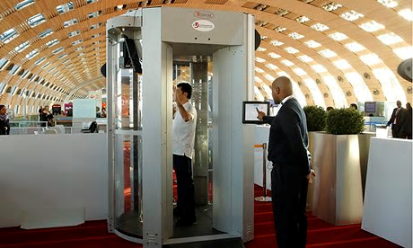
Full Body Scanners
A full-body scanner is a device that detects objects on a person’s body for security screening purposes, without physically removing clothes or making physical contact
They do not detect inside the body.
Alternative to pat down or strip searches

Slide 75
Break
Security Systems and their Operation
Maintenance and Calibration
Inspection, Control and
Monitoring Techniques

Slide 76
Maintenance and Calibration
Follow Manufacturers Directions
Utilize All Safety Measures when dealing with equipment
Recertify or Recalibrate Equipment regularly
A critical piece of technical problems…
The Operator!
Operating Skills
Proper Training
Vigilance

Slide 77
Questions
Break Be back in 10 Min

Slide 78
Break
The Meaning and Consequential Requirements of the different MARSEC Levels

Slide 79
MARSEC LEVELS
What are they?
What Color are they?
Who sets the MARSEC Level?
Attainment time? (How long you have to comply)

Slide 80
What is MARSEC?
33 CFR 105.220, 101.200 and 101.405
Maritime Security (MARSEC) Level means the level set to reflect the prevailing threat environment to the marine elements of the national transportation system, including ports, vessels, facilities, and critical assets and infrastructure located on or adjacent to waters subject to the jurisdiction of the U.S.
Think of MARSEC Levels as a term used for the delineation of threat levels. Now, you have heard of the Homeland Security threat levels of Blue, Yellow, Orange, and red. Well, think of MARSEC Levels as the same thing only without the colors. In the maritime community there are only three levels. MARSEC 1,2 and 3. MARSEC level 1 would be the equivalent of Homeland Securities YELLOW threat level. In the maritime industry, this is considered the new normalcy. MARSEC 2 would correlate to Homeland Securities ORANGE threat level and MARSEC 3 with Homeland Securities RED threat level.
The MARSEC Levels have a direct correlation with the ISPS (International Ship and Port Facility Security) standard worldwide threat levels. They have a different meaning than the homeland security threat levels as they are specifically designed for the national maritime transportation system.
Once the MARSEC Level is raised by the Commandant of The USCG, you have 12 hours to be in compliance with directives stipulated in the FSP and to report the attainment to the COTP.

Slide 81
MARSEC LEVELS
Response to change in MARSEC Level:
33 CFR 105.230
These changes will be reflected in the FSP and Post Orders.
Items that change as MARSEC Level Changes are;
Access Control
Restricted Areas
Cargo Handling
Delivery Vehicles
Monitoring

Slide 82
TWIC and Escorting
Familiar with all relevant aspects of the TWIC program and how to carry them out

Slide 83
Transportation Worker Identification Credential (TWIC)
What is a TWIC?
The TWIC program is a Transportation Security Administration (TSA) and U.S. Coast Guard (USCG) initiative and a requirement of the Maritime Transportation Security Act of 2002 (MTSA). The program provides a tamper-resistant biometric credential to anyone who needs unescorted access to secure areas of MTSA facilities.
To obtain a TWIC, an individual must provide biographic and biometric information (fingerprints), sit for a digital photograph and successfully pass a security threat assessment conducted by TSA.

Slide 84
Transportation Worker Identification Credential (TWIC)
TWIC training requirements for security personnel…
33 CFR 105.120 and NVIC 03-07 3.3g(2) require facility personnel with security duties “to be knowledgeable in and able to demonstrate familiarity with all requirements of the TWIC program.” Specifically,
How TWIC applies to your facility
Secure/Restricted area locations and requirements
Escorting requirements
Access for individuals who have reported a lost, stolen or damaged TWIC
Recognition of a valid TWIC
Resolution of violations (forged or tampered TWIC)

Slide 85
Transportation Worker Identification Credential (TWIC)
How TWIC applies to your facility…
TWIC is required in the Secure Areas located on your MTSA regulated footprint. Restricted Areas can be located within the Secure Area and these areas are known as Secure/Restricted. Anyone granted unescorted access to the Secure or Secure/Restricted areas of the facility will need a TWIC card. Examples:
1. Employees with frequent access to secure area or Secure/Restricted area.
2. Contractors working in any Secure or Secure/Restricted area of the facility
3. Delivery personnel who need unescorted access beyond the main gate into the Secure or Secure/Restricted Areas.
4. Companies on the gate log going to perform services for moored vessels
Anyone with unescorted access must have their TWIC on their person at all times or within ten minutes of their work station. The USCG will verify the presence of a TWIC during compliance audits and spot inspections.

Slide 86
Transportation Worker Identification Credential (TWIC)
Escorting requirements…
Escorting means “ensuring that the escorted individual is continuously accompanied while within a secure area in a manner sufficient to observe whether the escorted individual is engaged in activities other than those for which escorted access was granted” (33 CFR 101.105).
The escort must be a physical side-by-side presence in secure/restricted areas. Such a presence requires close physical proximity to and visual contact with the escorted individual in order to enable the TWIC holder to witness the escorted individual’s actions (NVIC 03-07 3.3c(3)).
Key Performance Standard: Is the person I am escorting doing something they are not authorized to do or trying to go somewhere they are not authorized to be?
Escorting Ratio: In a Secure/Restricted Area, 1 TWIC holder can escort up to 5 non-TWIC holders. If you are just in a Secure Area the ratio can be 1 TWIC escort up to 10 non-TWIC holders.

Slide 87
Transportation Worker Identification Credential (TWIC)
Access for individuals who have reported a lost, stolen or damaged TWIC…
If an individual’s TWIC is lost, stolen, or damaged, he/she must report it immediately to the FSO then to TSA (through the TSA TWIC help desk at 1-866-DHS-TWIC). TSA will revoke the card and begin the process of producing a new TWIC, which must be picked up at an enrollment center designated by the individual.
During that period after the TWIC has been reported as lost, stolen, or damaged and while a new one is being produced, the individual may be granted unescorted access to the facility for 7 consecutive calendar days under the following circumstances:
Note: This provision is not for someone who left their card at home!

Slide 88
Transportation Worker Identification Credential (TWIC)
Access for individuals who have reported a lost, stolen or damaged TWIC…
(a) The individual can present another identification credential that meets the requirements of 33 CFR 101.515 (e.g. driver’s license).
(b) The FSO or designee verifies that the individual had a valid TWIC and has previously been granted unescorted access to secure areas of the vessel or facility (recommended within the past 90 days). This can be done by checking employee lists, records of access, or knowledge of security staff.
(c) The individual has reported the TWIC as lost, stolen, or damaged to TSA.
(d) There are no other suspicious circumstances associated with the individual’s claim of loss, theft, or damage. Examples of suspicious circumstances include repeat claims of loss, theft, or damage, questionable explanations for the loss, or coming to work with the TWIC a day or two after claiming it was lost, stolen, or damaged.

Slide 89
Transportation Worker Identification Credential (TWIC)
Escort Guidance | Secure areas that are also Restricted Areas
TWIC Holders | Unescorted
Lost, stolen or damaged TWIC | Unescorted access up to 7 calendar days
Non-TWIC | Escorted—side by side accompaniment (1 TWIC to 5 escorted in secure/restricted areas and 1 to 10 in Secure Areas)
Foreign Mariners **Foreign Mariners are not required to get a TWIC | Escorted—side by side accompaniment (1 TWIC to 5 escorted) May work immediately adjacent to vessel without a TWIC …the TWIC requirements will not apply to mariners while in the immediate vicinity of their vessel when performing routine ships business (in which mustering for transportation off the facility can be included) NVIC 03-07 Enclosure 3.3 c(7)

Slide 90
Transportation Worker Identification Credential (TWIC)
Recognition of a valid TWIC…
TWIC verification processes must include the following provisions for credential verification:
(1) A match of the photo on the TWIC to the individual presenting the TWIC;
(2) Verification that the TWIC has not expired; and
(3) A visual check of the various security features present on the credential to ensure that the TWIC has not been forged or tampered with.

Slide 91
Transportation Worker Identification Credential (TWIC)
Recognition of a valid TWIC…
Specific policies and procedures for verifying a TWIC are put in place.
USCG gives two options for verifying a TWIC at this time:
Presentation and verification of a TWIC upon each entry into the secured area every time. For example, before the Plant Manager is granted access to the terminal you must verify his TWIC. Every day. Every time. If he leaves and comes back (e.g. lunch), you must verify again. Every day. Every time.

Slide 92
Transportation Worker Identification Credential (TWIC)
Laminate Security Features
Transportation Worker Identification Credential

Slide 93
Vehicle Inspections

Slide 94
Transportation Worker Identification Credential (TWIC)
Resolution of violations (forged or tampered TWIC)…
If a TWIC is presented at a facility and is suspected to be fraudulent, security personnel should, at a minimum:
Deny the individual unescorted access to secure areas of the facility.
2. Check the person’s identity by asking for one of the alternate forms of identification described in 33 CFR 101.515 (e.g. state driver’s license). Carefully inspect this identification for signs of tampering and authenticity.
3. Request the person’s name, address and other contact information. Carefully record any information given, including the information on the TWIC. Make a photocopy of the TWIC if possible.

Slide 95
Transportation Worker Identification Credential (TWIC)
Resolution of violations (forged or tampered TWIC)…
4. The COTP should be called and the duty officer informed that a TWIC suspected to be fraudulent has been presented. Provide all requested information and follow any instructions that the duty officer provides.
5. If directed by the Coast Guard, ask the individual to remain at the access control point until the Coast Guard or other law enforcement agency arrives. Do not make any attempt to restrain the individual or inform him/her that they may not leave.
6. Follow any additional notifications as required by your FSP

Slide 96
Transportation Worker Identification Credential (TWIC)
Escorting in enclosed vehicles…
Escorting ratios do not apply when non-TWIC holders are transported in an
enclosed vehicle. In this case, one TWIC holder who is driving or riding in the
vehicle can escort any number of passengers as long as they are only allowed to
depart the vehicle in a location where other TWIC holders will be able to escort
them or where they will not need to be escorted (e.g. a public access area or
outside the facility). This applies in both secure areas and secure/restricted areas. Escorting requirements must be met once the non-TWIC holders depart the vehicle--NVIC 03-07 Enclosure 3.3c(4)

Slide 97
Sensitive Security Information (SSI)
Guidelines for handling of sensitive security information.
49 CFR 1520 governs SSI
Navigation and Vessel Inspection Circular (NVIC), explains how the law will be interpreted and enforced.

Slide 98
SSI
Sensitive Security Information (SSI) is a category of sensitive but unclassified information under the United States government’s information sharing and control rules.
SSI is information obtained in the conduct of security activities whose public disclosure would, in the judgment of specified government agencies, harm transportation security, be an unwarranted invasion of privacy, or reveal trade secrets or privileged or confidential information.
SSI should be marked with the appropriate marking and distribution limitation statement as described below.
The cover page or first page of the document shall prominently display the SSI marking and the distribution limitation statement. Each subsequent page of the document that contains SSI should also display the SSI marking and distribution limitation statement. The SSI marking should be conspicuously placed on the top of the page and the distribution limitation statement on the bottom.

Slide 99
SSI marking and Distribution Statement.
SENSITIVE SECURITY INFORMATION
“WARNING” THIS RECORD CONTAINS SENSITIVE SECURITY INFORMATION THAT IS CONTROLLED UNDER THE PROVISIONS OF 49 CFR 1520. NO PART OF THIS RECORD MAY BE DISCLOSED TO PERSONS WITHOUT A “NEED TO KNOW” AS DEFINED IN 49 CFR 1520, EXCEPT WITH THE WRITTEN PERMISSION OF THE ADMINISTRATOR OF THE TRANSPORTATION SECURITY ADMINISTRATION. UNAUTHORIZED RELEASE MAY RESULT IN CIVIL PENALTY OR OTHER ACTION. FOR U.S. GOVERNMENT AGENCIES, PUBLIC DISCLOSURE IS GOVERNED BY 5 U.S.C. 552 AND 49 CFR PART 1520

Slide 100
What would be considered SSI?
There are several things that can be considered SSI and the following are listed in 10-4 of the Navigation and Vessel Inspection Circular.
Security Programs and Contingency Plans.
Security Directives
Information Circulars
Performance Specifications
Vulnerability Assessments
Security Inspection or Investigative Information.
Threat Information
Security Measures.
Security Screening Information.
Security Training Materials.
Identifying Information of Certain Transportation Security Personnel.
Critical Maritime Infrastructure asset Information.
System Security Information
Confidential Business Information.
Research and Development Information.
Other Information.

Slide 101
QUESTIONS?

Slide 102
FSP Definitions

Slide 103
FSP Definitions
Alternate Security Program – Third party of industry organization developed standard that the Commandant has determined provides an equivalent level of security to that established by 33CFR, Subchapter H – Maritime Security.
Area Commander – The United States Coast Guard Officer designated by the Commandant to command a Coast Guard Area as described in 33 CFR Part 3.

Slide 104
FSP Definitions
Audit – An evaluation of a security assessment or security plan performed by an owner or operator, the owner or operator’s designee, or an approved third party, intended to indentify deficiencies, non-conformities and or inadequacies that would render the assessment or plan insufficient.
Barge – a non self propelled ship per (46 CFR 24.10-1)

Slide 105
FSP Definitions
Barge Fleeting Facility – A commercial area, subject to permitting by the Army Corps of Engineers, as per (33 CFR Part 322, Part 330) or pursuant to a regional general permit. The purpose of which is for making up , breaking down, or staging of barge tows.
Breach of Security – An incident that has not resulted in a transportation security incident, in which security measures have been circumvented, eluded, or violated.

Slide 106
FSP Definitions
Bulk/In Bulk – A commodity that is loaded or carried on board a ship without containers or labels, and that is received and handled without mark or count.
Bunkers – S ships fuel supply.

Slide 107
FSP Definitions
Captain of the Port – The local Coast Guard Officer exercising for the COTP zones described in 33 CFR Part 3. The COTP is the Federal Maritime Coordinator described in 46 U.S.C. 70103(a)(2)(G), and also the Port Facility Security Officer as described in the ISPS Code, Part A.
Cargo – Any goods, wares, or merchandise carried, or to be carried, for consideration, whether directly or indirectly flowing to the owner, charter, operator, agent, or any person interested in the ship, facility, or OCS facility, expect dredge spoils.

Slide 108
FSP Definitions
Certain Dangerous Cargo – The same as in 33 CFR 160.204.
Commandant – The Commandant of the Coast Guard
Company – Any person or entity that owns the facility, ship, OCS facility subject to the requirements of the 33 CFR Subchapter H, or has assumed the responsibility for operations of any facility, ship, or OCS facility.

Slide 109
FSP Definitions
Cruise Ship – Any ship over a 100 gross registered tons, carrying more than 12 passengers for hire which makes voyages lasting more than 24 hours, of which any part is on the high seas.
Dangerous goods / Hazardous Cargo – Cargoes regulated by 33 CFR Parts 126,127,154.
Dangerous substances/ Devices - Any material, substance, or items that reasonably has the potential to cause a transportation security incident.

Slide 110
FSP Definitions
Declaration of Security – An agreement executed between the responsible vessel/ship and the FSO, or between the Vessels Security Officer VSO. In the case of a ship to ship activity, that provides a means for ensuring that all shared security concerns are properly addressed and security will remain in place throughout the time the ship is moored to the facility or the duration of the ship to ship activity.
District Commander – The US Coast Guard Officer designated by the Commandant to command a CG District described in 33 CFR Part 3.
Drill – A training event that test at least one component of the AMS, ship, of facility security plan and is used to maintain a high level of security readiness.

Slide 111
FSP Definitions
Escorting – Ensuring that the escorted individual is continuously accompanied while within a secure area in a manner sufficient to observe whether the escorted individual is engaged in activities other than those for which escort access was granted. This may be accomplished via having a side by side companion or monitoring, depending upon where the escorted individual will be granted access. Individuals without TWICs may not enter restricted areas without having an individuals who holds a TWIC as a side by side companion, except as provided in 104.267,105.257,106.262 of this subchapter.
Exercise - A comprehensive training event that involves several of the functional elements of the FSP.

Slide 112
FSP Definitions
Facility – Any structure or facility of any kind located in, on, under or adjacent to any waters subject to the jurisdiction of the U.S. and used, operated, or maintained by the public or private entity, including any contiguous or adjoining property under common ownership or operation.
Facility Security Assessment – An analysis that examines and evaluates the infrastructure and operations of the facility taking into account possible threats, vulnerabilities, consequences, and existing protective measures, procedures and operations.

Slide 113
FSP Definitions
Facility Security Officer (FSO) – The person designated as responsible for the development, implementation, revision, and maintenance of the facility security plan and for liaison with the COTP and Company and Ship Security Officer.
Facility Security Plan (FSP) – The plan developed to ensure the application of security measures designed to protect the facility and its servicing ships or those ships interfacing with the facility, their cargos, and persons on board at the respective MARSEC Levels.

Slide 114
FSP Definitions
Hazardous Materials – Hazardous materials subject to regulation under 46 CFR Parts 148, 150, 151, 153, 154, and 49 CFR Parts 171 through 180.
Infrastructure – Facilities, structure, systems, assets, or services so vital to the port and its economy that their disruption, incapacity, or destruction would have a debilitating impact on the defense, security, the environment, long term economic prosperity, public health or safety of the port.

Slide 115
FSP Definitions
ISPS Code – The International Ship and Port Facility Security Code, as incorporated in SOLAS.
Maritime Security Level (MARSEC) – The level set to reflect the prevailing threat environment to the maritime elements of the national transportation system, including ports, ships, facilities, and critical assets and the infrastructure located on or adjacent to waters subject of the jurisdiction of the U.S.

Slide 116
FSP Definitions
MARSEC Level 1 – The level for the which minimum appropriate protective security measures will be maintained at all times.
MARSEC Level 2 – The level for which appropriate additional protective security measures will be maintained for a period of time as a result of heightened risk of a transportation security incident.
MARSEC Level 3 – The level for which further specific protective security measures will be maintained for a limited period of time when a transportation security incident is probable or imminent, although it may not be possible to identify the specific target.

Slide 117
FSP Definitions
OCS Facility – Any artificial island, installation, or other complex or more structures permanently or temporarily attached to the subsoil or seabed of the OCS, erected for the purpose of exploring for, developing or producing oil, natural gas or mineral resources. This definition includes all offshore frilling units (MODO) not covered under 33 CFR Part 104, when attached to the subsoil or subsoil or seabed of the offshore locations, but does not include deepwater ports, as defined in 33U.S.C. 1502, or pipelines.
Owner/Operator – Any person or entity that owns, or maintains operational control over, and facility, ship, or OCS facility subject to 33 CFR Subchapter H. This includes a towing ship that has operational control of an unmanned ship when the unmanned ship is attached to the towing ship and a facility that has operational control of an unmanned ship when the unmanned ship is not attached to a towing ship and is moored to the facility; attachment begins with the securing of the first mooring line and ends with the casting-off of the last mooring line.

Slide 118
FSP Definitions
Personal Identification Number (PIN) – A personally selected number stored electronically on the individuals TWIC.
Passenger Ship – Shop on an international voyage, a ship carrying more than 12 passengers including at least one passenger for hire; a ship of at least 100 gross registered tons carrying more than 12 passengers including at least one passenger for hire; a ship less than 100 gross registered tons carrying more than 6 passengers, including at least one passenger for hire; a ship that is charted and carrying at least one passenger for hire; a submersible ship that is carrying at least one passenger for hire; a wing in ground craft, regardless of tonnage, that is carrying at least one passenger for hire.

Slide 119
FSP Definitions
Public Access Facility– Facility that is used by the public primarily fore the purpose such as recreation, entertainment, retail, or tourism, and not receiving ships subject to 33CFR Part 104; has normal infrastructure for servicing ships subject to 33CFR Part 104; receives only ships not subject to 33 CFR Part 104, or passenger ships, except: Ferries certified to carry vehicles, Cruise ships, Passenger ships subject to SOLAS Chapter XI.
Recurring unescorted access – Recurring unescorted access means authorization to enter a vessel on a continual basis after an initial personal identity and credential verification.
Restricted Area – The infrastructures or locations identified in an area, ship, or facility security assessment or by the operator that require limited access and a higher degree of security protection. The entire facility may be designated the restricted area, as long as the entire facility is provided the appropriate level of security.

Slide 120
FSP Definitions
Review and Approval – The process whereby Coast Guard officials evaluate a plan or proposal to determine if it complies with 33 CFR Subchapter H and or provides an equivalent level of security.
Screening - A reasonable examination of persons, cargo, vehicles, or baggage for the protection of the ship, its passengers and crew. Screening is to secure the vital government interest of protecting ships, harbors, and waterfront facilities from destruction, loss, or injury from sabotage or other causes that in similar nature. Screening is intended to ensure that dangerous substances or devices, or other items that pose a real danger of violence or threat to security are not present.

Slide 121
FSP Definitions
Secure Area – The area on board a vessel or at a facility or outer continental shelf facility over which the owner/operator has implemented security measures for access control in accordance with a Coast Guard approved security security plan. It does not include passenger access areas, employee access areas, or public access areas, as those terms are defined in 33CFR104.106,104.107,105.106, respectively , of this subchapter. Vessels operating under the waivers provided for at 46CFR U.S.C. 8103(b)(3)(A) or (B) have no secure areas. Facilities subject to part 105 of this subchapter may, with approval of the Coast Guard, designate only those portions of their facility that are directly connected to maritime transportation or are at risk of being involved in a transportation security incident as their secure areas.
Security Patrol - A walkthrough to visually inspect unrestricted areas to indentify unattended packages, briefcases, or luggage and determine that all restricted areas are secure.

Slide 122
FSP Definitions
Security System – A device or multiple devices designed, installed and operated to monitor, detect, observe or communicate about activity that may pose a security threat in a location or locations on a ship or facility.
Sensitive Security Information(SSI) - Information within the scope of 49 CFR Part 1520.
SOLAS - The International Convention for the Safety of Life at Sea Convention, 1974, as amended.

Slide 123
FSP Definitions
Transportation Security Incident – A security incident resulting in a significant loss of life, environmental damage, transportation, or economic disruption in a particular area.
TWIC - Transportation Workers Identification Credential as per 49CFR1572.
Unaccompanied Baggage – Any Baggage, including personal effects, that are not being brought on board on behalf of a person who is boarding.

Slide 124
FSP Definitions
Ship to Facility Interface– The interaction that occurs when a ship is directly and immediately affected by actions involving the movement of persons, cargo, ship stores, or the provisions of the facility services to or from the ship.
Ship to Port Interface - The interaction that occurs when a chip is directly and immediately affected by the movement of persons, cargo, ship stores, or the provisions of port services to or from the ship .
Unaccompanied Baggage – Any Baggage, including personal effects, that are not being brought on board on behalf of a person who is boarding.

Slide 125
FSP Definitions
Ship Stores – Materials that are on board a ship for the upkeep, maintenance, safety, comfort of the ships crew/passengers, or the operations of navigation of the ship
Waters subject to the jurisdiction of the U.S – 33CFR Subchapter H, includes all waters described in Chapter 2.36(a) of 33CFR Chapter I. The Exclusive Economic Zone, in respect to the living and nonliving resources therein and in respect to facilities located on the OCS of the U.S.

